Slide 1
ECON747: Spatial Econometric Models and Methods – Lab 7
Term I, 2024-2025
Yang Zhenlin
zlyang@smu.edu.sg
http://www.mysmu.edu/faculty/zlyang/

Slide 2
FE-SDPD Model – Tests of Hypotheses

Slide 3
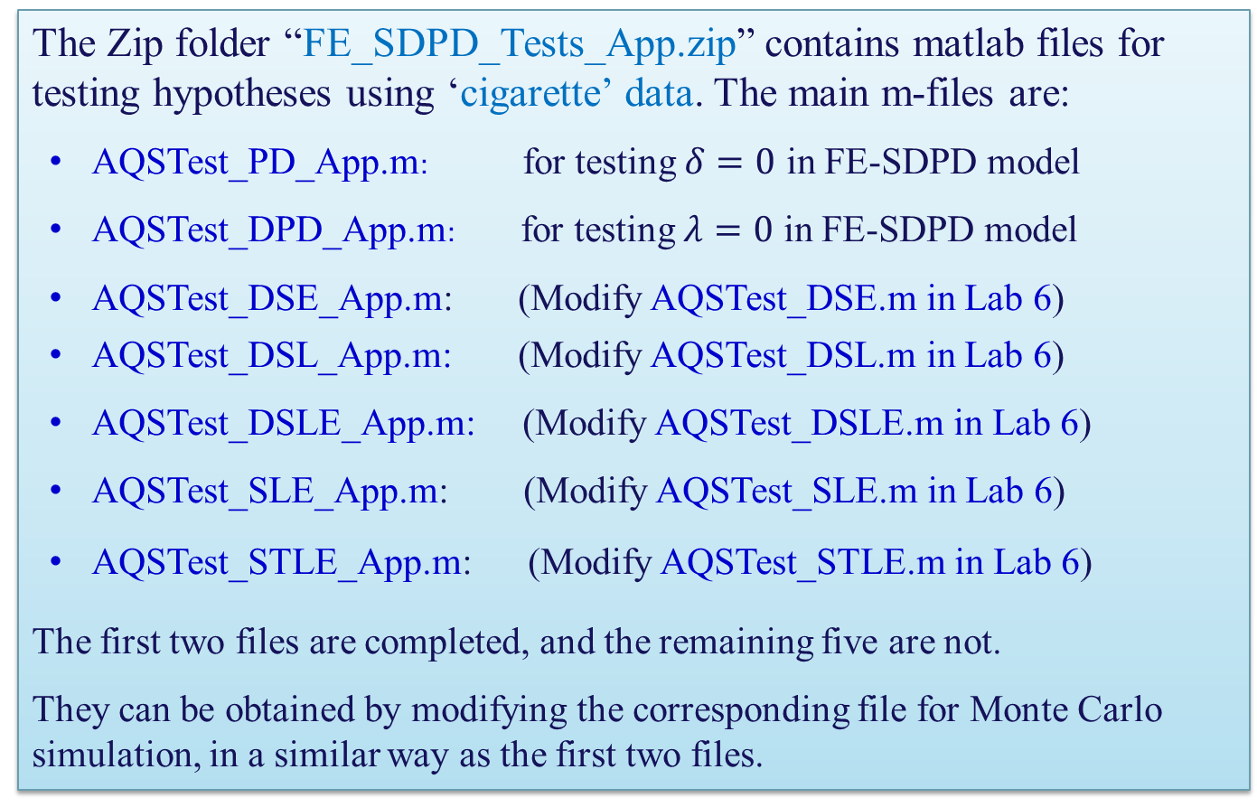
Tests for FE-SDPD Model with Matlab
The Zip folder “FE_SDPD_Tests_App.zip” contains matlab files for testing hypotheses using ‘cigarette’ data. The main m-files are:
AQSTest_PD_App.m: for testing $δ=0$ in FE-SDPD model
AQSTest_DPD_App.m: for testing $λ=0$ in FE-SDPD model
AQSTest_DSE_App.m: (Modify AQSTest_DSE.m in Lab 6)
AQSTest_DSL_App.m: (Modify AQSTest_DSL.m in Lab 6)
AQSTest_DSLE_App.m: (Modify AQSTest_DSLE.m in Lab 6)
AQSTest_SLE_App.m: (Modify AQSTest_SLE.m in Lab 6)
AQSTest_STLE_App.m: (Modify AQSTest_STLE.m in Lab 6)
The first two files are completed, and the remaining five are not.
They can be obtained by modifying the corresponding file for Monte Carlo simulation, in a similar way as the first two files.

Slide 4
Matlab Sub-Functions
The sub-functions common for all main m-files, for computing various matrices:
Fn_BMat.m
Fn_Bmat_1.m
Fn_CMat.m
Fn_DMat.m
Fn_DMat_1.m
Fn_RMat.m
Fn_Rmat_1.m
The sub-functions for estimating the null models:
Fn_AqsDPD.m
Fn_AqsDSE.m
Fn_AqsDSE.m
Fn_AqsDSL.m
Fn_AqsDSLE.m
Fn_AqsSLE.m
Fn_AqsSTLE.m
The main m-files are written in a way they can easily be applied to other data set such as ‘Munnell’ data or ‘fatality’ data, by simply replacing the data input part at the beginning of the main file.

Slide 5
FE-SDPD Model – Cigarette Demand Data
State | Year | Price | Pop | Pop16 | CPI | NDI | C | PiMin
1 | 63 | 28.6 | 3383 | 2236.5 | 30.6 | 1558.305 | 93.9 | 26.1
3 | 63 | 23.9 | 1517 | 982.4 | 30.6 | 1944.745 | 125 | 24.9
4 | 63 | 27 | 1907 | 1296.7 | 30.6 | 1480.333 | 103.4 | 25.8
5 | 63 | 25.3 | 17556 | 12072 | 30.6 | 2776.097 | 142 | 23.9
7 | 63 | 26.8 | 2716 | 1883.5 | 30.6 | 2913.68 | 156.2 | 26.2
8 | 63 | 26.8 | 480 | 317.7 | 30.6 | 2261.462 | 165.8 | 26.8
9 | 63 | 23.4 | 792 | 563.1 | 30.6 | 2733.227 | 246.4 | 24.7
10 | 63 | 26.3 | 5532 | 3996.8 | 30.6 | 1980.687 | 137.5 | 26.9
11 | 63 | 26.9 | 4206 | 2768.4 | 30.6 | 1743.939 | 108.3 | 26.1
13 | 63 | 28 | 689 | 451.6 | 30.6 | 1938.814 | 97 | 24.9
14 | 63 | 25.4 | 10369 | 7115.8 | 30.6 | 2655.691 | 145.5 | 24.1
15 | 63 | 24.4 | 4780 | 3206.7 | 30.6 | 2204.326 | 138.5 | 24.1
16 | 63 | 26.4 | 2758 | 1880.7 | 30.6 | 2153.014 | 114.9 | 25.4
…
See cigar.xlsx for full data, and cigar_readme.txt for a description of the data.

Slide 6
FE-SDPD Model – Cigarette Demand Data
The subsequent analyses are based on the transformed data give in the file cigarette.xls,
where
column A: observation
column B: state
column C: year
column D: ln(cigarette sales in packs per capita)
column E: ln(price per pack of cigarettes/CPI)
column F: ln(per capita disposable income/CPI)
column G: ln(min price in adjoining states per pack of cigarettes/CPI)
column H: population
column I: population above the age of 16
See cigarette_reame.txt for a detailed description of the data.
For the original data, see cigar.xlsx and cigar_readme.txt

