Slide 1
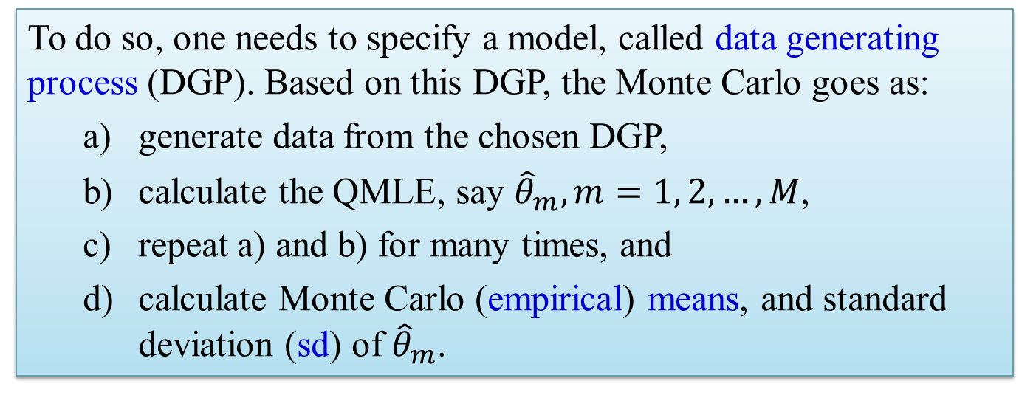
Monte Carlo Simulation
We introduce basics for Monte Carlo Simulation, for the purpose of assessing the finite sample performance of the estimators, test statistics, etc. In the context of spatial linear regression (SLR) model, it is known that QMLEs are downward biased. How biased can they be? How does it affect the subsequent inferences?
To do so, one needs to specify a model, called data generating process (DGP). Based on this DGP, the Monte Carlo goes as:
generate data from the chosen DGP,
calculate the QMLE, say ${\hat{θ}}_{m}, m=1, 2, …, M$,
repeat a) and b) for many times, and
calculate Monte Carlo (empirical) means, and standard deviation (sd) of ${\hat{θ}}_{m}$.
zlyang@smu.edu.sg http://www.mysmu.edu/faculty/zlyang/ Zhenlin Yang

Slide 2
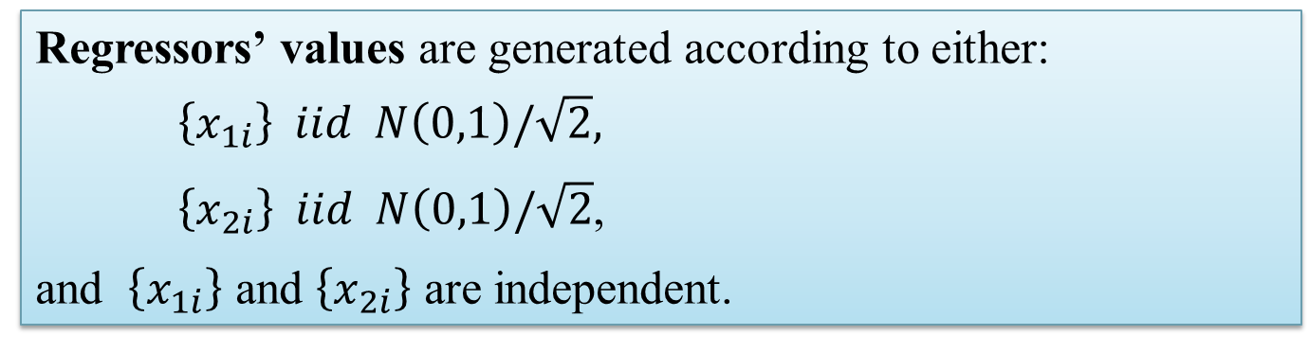
Monte Carlo – QMLE of SLD Model
Consider the following DGP – an SLD model:
Y_{n} = λW_{n}Y_{n} + β₀1_{n}+ X₁β₁ + X₂β₂ + σe_{n}
where β′ = (β₀, β₁, β₂) = (5, 1, 1), σ = 1, λ = {.5, .25, 0, -.25, -.5}.
Regressors’ values are generated according to either:
$\left\{x_{1i}\right\} iid N\left(0,1\right)/\sqrt{2},$
$\left\{x_{2i}\right\} iid N\left(0,1\right)/\sqrt{2}$,
and $\left\{x_{1i}\right\}$ and $\left\{x_{2i}\right\}$ are independent.
The spatial weight matrix W_{n} is generated according to
Rook contiguity,
Queen contiguity,
group interaction.

Slide 3
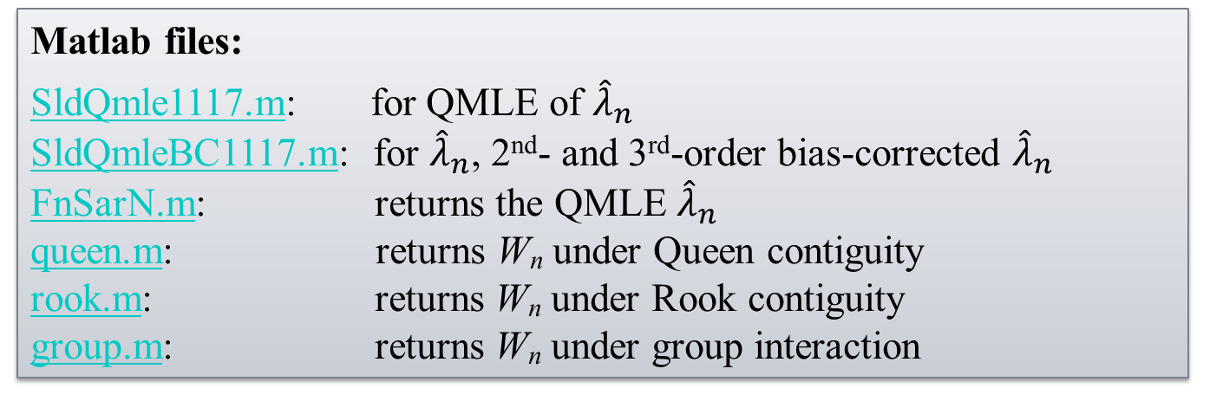
Monte Carlo – QMLE of SLD Model
The errors {e_{ni}} are iid, generated from (i) standard normal, (ii) normal mixture, and (iii) lognormal, where in (ii) and (ii), random variates are standardized to have mean 0 and variance 1.
See Yang (2015, JOE: A general method …) for details on these; also for details on 2nd- and 3rd-order bias-corrected QMLEs.
Matlab files:
SldQmle1117.m: for QMLE of ${\hat{λ}}_{n}$
SldQmleBC1117.m: for ${\hat{λ}}_{n}$, 2nd- and 3rd-order bias-corrected ${\hat{λ}}_{n}$
FnSarN.m: returns the QMLE ${\hat{λ}}_{n}$
queen.m: returns W_{n} under Queen contiguity
rook.m: returns W_{n} under Rook contiguity
group.m: returns W_{n} under group interaction

Slide 4
Monte Carlo – QMLE of SLD Model

Slide 5
Monte Carlo – QMLE of SLD Model

Slide 6
Monte Carlo – QMLE of SLD Model

